Slide 1
Investigation of Insurance Charges
Adrien Sesco

Slide 2
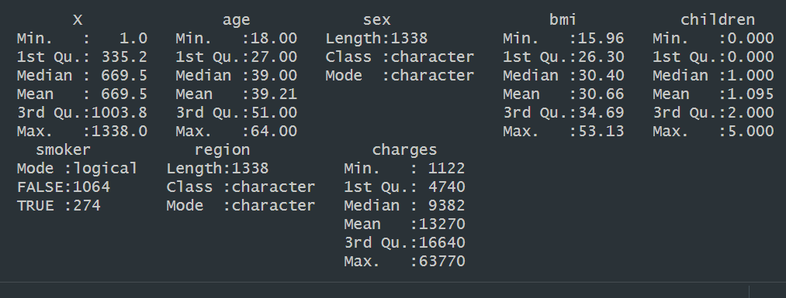

Slide 3
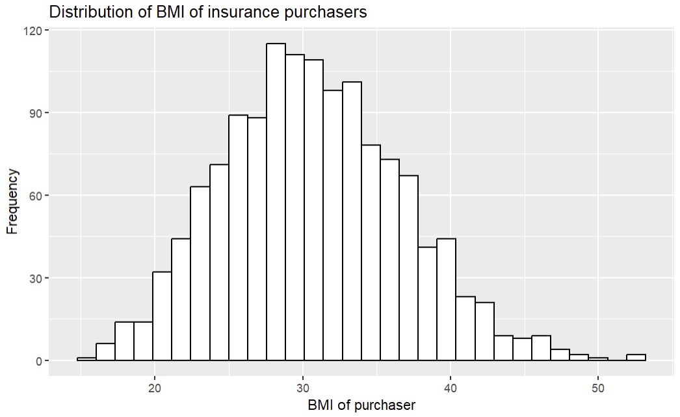


Slide 4
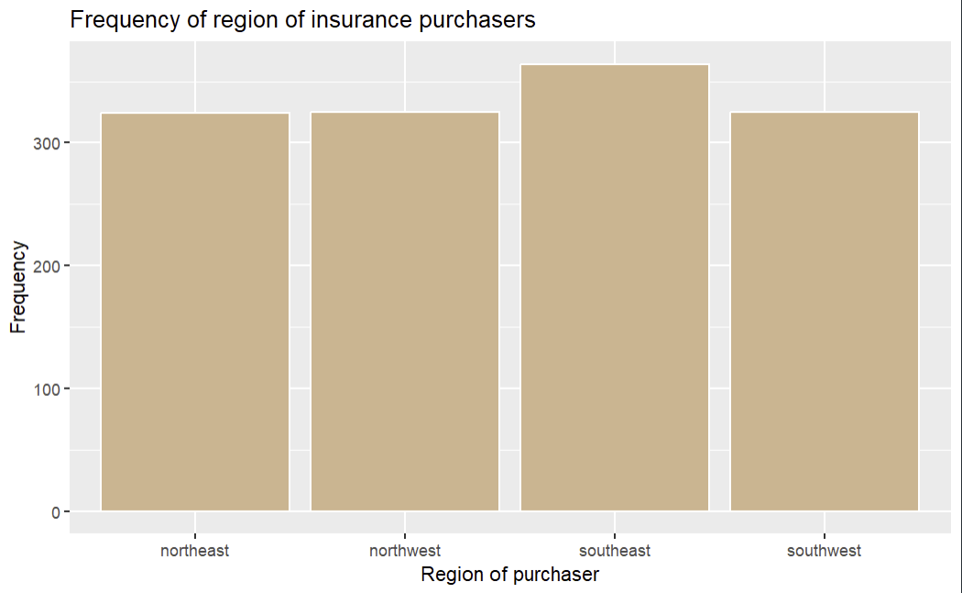

Slide 5
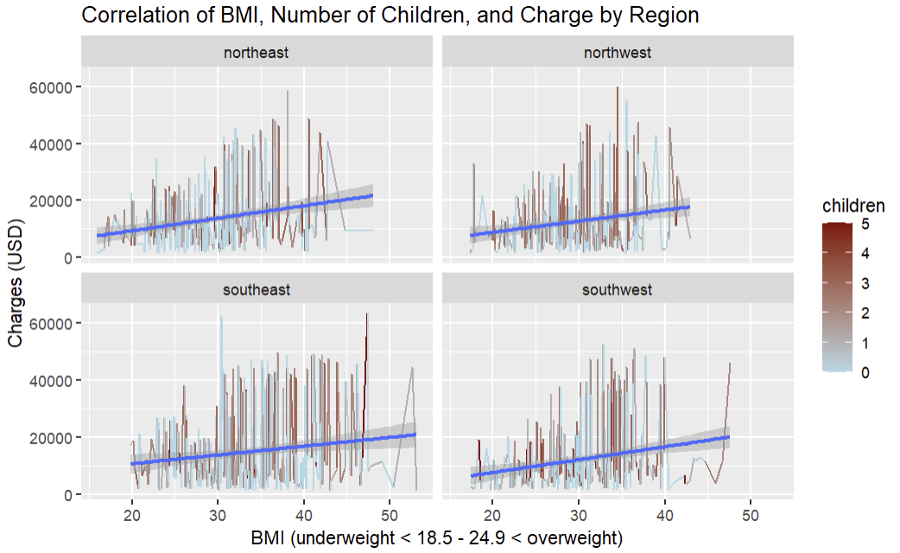

Slide 6
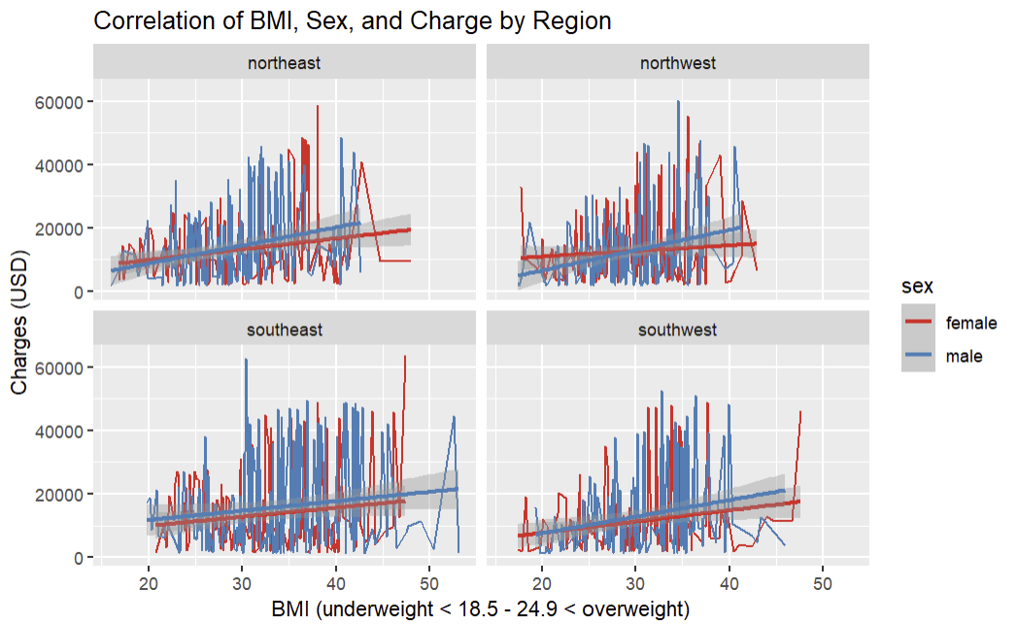

Slide 7
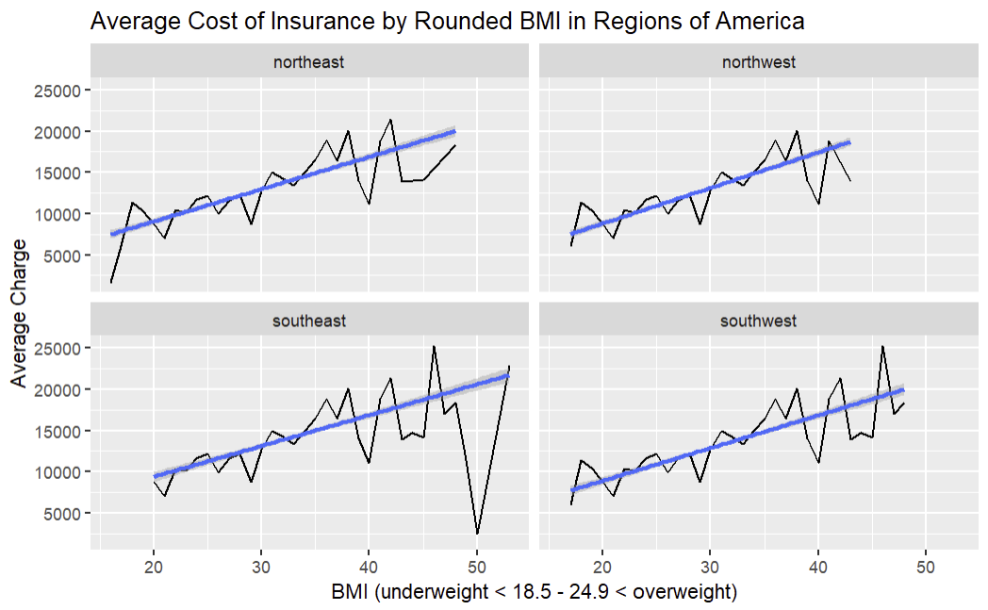

Slide 8
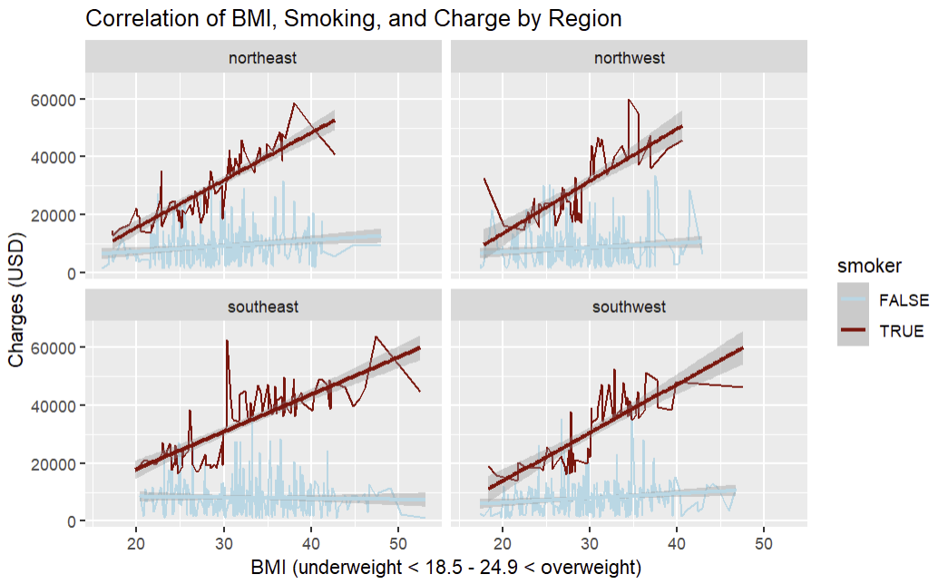

Slide 9
References
https://www.kaggle.com/datasets/mosapabdelghany/medical-insurance-cost-dataset/data

